Slide 1

Nationalism and Brexit

Slide 2
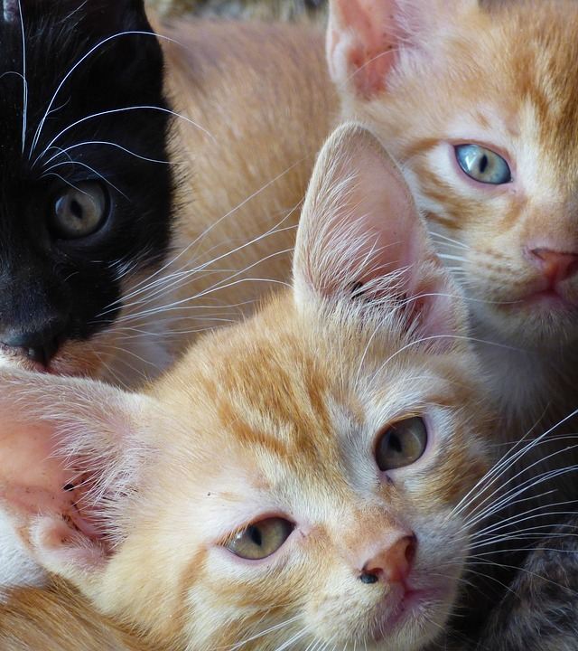
Today’s Class
Natonalism Defintion
Positive and Negative Outcomes of Nationlism
Brexit

Slide 3
Sharing the Planet
IO Theme Questions
How has nationalism shaped your country's history?
Can nationalism exist without excluding others?
Are modern nationalist movements more positive or negative?

Slide 4

Nationalism
Nationalism is the belief in the superiority and interests of one’s nation above others, often emphasizing a shared culture, language, or heritage.
Elements: Common identity, unity, pride in national achievements, and advocacy for independence or sovereignty

Slide 5
Types of Nationalism
Civic Nationalism: Inclusive, based on shared values and political beliefs (e.g., American Revolution).
Ethnic Nationalism: Exclusive, based on ethnicity or heritage (e.g., Nazi Germany).
Cultural Nationalism: Preservation and promotion of national culture.
Economic Nationalism: Emphasis on protecting national industries and resources

Slide 6
Positive Outcomes of Nationalism
Unification of Nations:
Example: German Unification (1871) under Otto von Bismarck, which created a strong, centralized state.
Independence Movements:
Example: Indian Independence (1947)—nationalism united diverse groups against colonial rule.
Cultural Renaissance:
Example: Irish Gaelic Revival in the late 19th century, which preserved and promoted Irish language and culture.

Slide 7
Negative Outcomes of Nationalism
Conflicts and Wars:
Example: World War I—excessive nationalism fueled tensions between European nations.
Exclusion and Oppression:
Example: Nazi Germany—ethnic nationalism led to the Holocaust and World War II.
Ethnic Cleansing and Division:
Example: Rwandan Genocide (1994)—nationalistic and ethnic tensions between Hutus and Tutsis.

Slide 8
Brexit
“Brexit” is the term used for the UK’s decision to leave the European Union after over 40 years. The decision was brought forward by the Prime Minister, voted on by the people and implemented by Parliment. After a two-year negotiation period, the UK officially left the EU in 2019.

Slide 9
The European Union
Advantages
Disadvantages
Shared Currency: The Euro
One Market (with the same Trade Agreements)
Ease of Movement for Citizens
Mutual Support (to emergencies)
Collective Response
Loss of Sovereignty
Budget Contributions
Overregulation
Divergent (political) Interests
Shared Risk

Slide 10
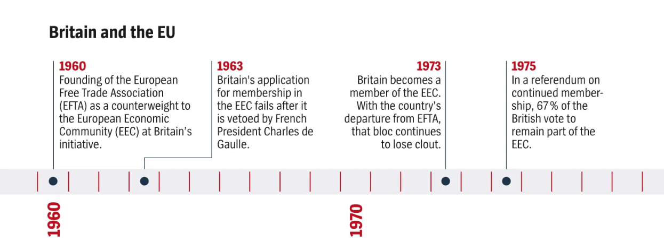

Slide 11
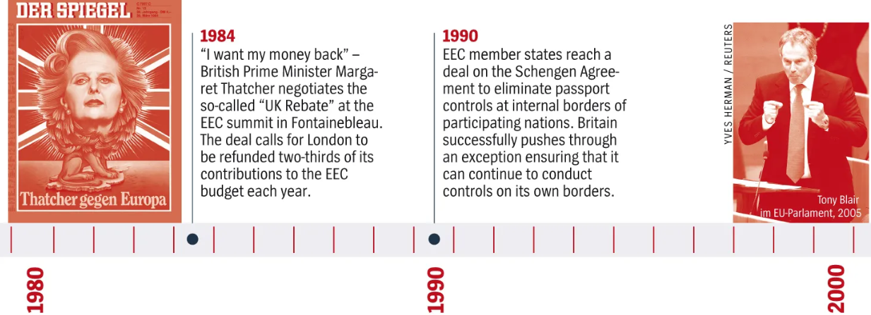

Slide 12
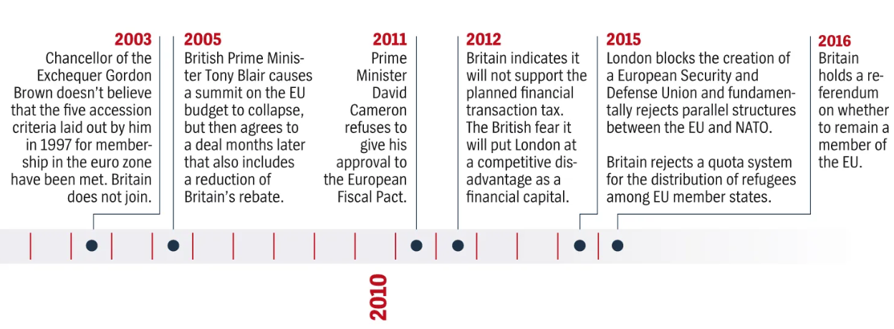

Slide 13
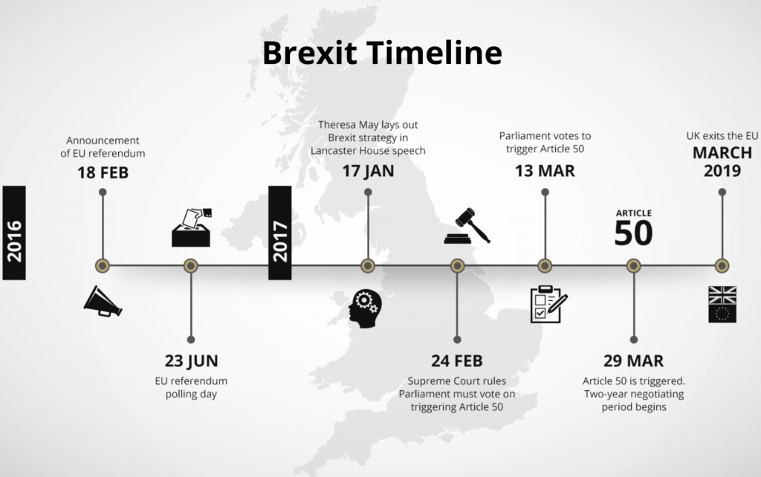

Slide 14
Brexit Now What do UK Netizens say?
Search the web and see what you can find about public opinions about how people feel about Brexit today.
Is there a common theme about what people are saying?
Is there a generational divide? (search: teens, middle age and elderly populations)
Is there a difference in opinion between Britain, Scotland, Wales and Northern Ireland?

Slide 15
Sharing the Planet
IO Theme Questions
How has nationalism shaped your country's history?
Can nationalism exist without excluding others?
Are modern nationalist movements more positive or negative?

